Slide 1
AHECB Meeting
May 1, 2015

Slide 2
AHECB Finance Committee Meeting
May 1, 2015

Slide 3
Agenda item no. 3: performance funding outcomes
Tara Smith
Senior Associate Director, Institutional Finance

Slide 4
Universities
Methodology
Total Possible Points = 10
Compares average of the most recent 2 years to an average of the previous 3 years (for most measures)
  Bachelor Degrees & All Credentials are measured against a goal of increasing by 4.73%
Compensatory points for percentage of Pell receiving undergraduates may be added to the total points, but cannot increase the total points above 10.

Slide 5
Universities
Mandatory Measures – maximum of 4 points
  Bachelor Credentials
  Total Credentials
  STEM Credentials
  Progression
Optional Measures – maximum of 6 points
  Minority Credentials
  Non-Traditional Credentials
  Remedial Credentials
  Transfer Student Credentials
  Course Completion
  External Grants & Awards
  Regional Economic Needs Credentials

Slide 6
Universities - Results

Slide 7
Universities - Highlights
Successes
All Credentials
Average % towards Goal = 106.1%
Median % towards Goal = 102.1%
Minority Credentials
Average % Change = 19.3%
Median % Change = 16.0%
Challenges
External Grants & Awards
Average % Change = -0.7%
Median % Change = 0.3%

Slide 8
Colleges
Methodology
Total Possible Points = 10
Compares average of the most recent 3 years to an average of the most recent 5 years
Compensatory points for special populations (based on percentage of enrollment) may be added to mandatory total

Slide 9
Colleges
Mandatory Measures – maximum of 6 points
  Course Completion
    Remedial
    Non-Remedial
  Progression
  Credentials
    Certificates of Proficiency
    Technical Certificates
    Associate Degrees
    Total Credentials (rate)
  Compensatory
    Low-Income
    Underprepared
Region/Mission Measures – maximum of 4 points
  STEM Credentials
  High Demand Credentials
  Adult Credentials
  Minority Credentials
  Transfer Students
  Workforce Training

Slide 10
Colleges - Results

Slide 11
Colleges - Highlights
Successes
Total Credentials per FTE
Average % Change = 9.0%
Median % Change = 9.9%
Workforce Training
Average % Change = 19.7%
Median % Change = 0.9%
Challenges
Progression
Average % Change = -1.2%
Median % Change = -1.0%

Slide 12
Funding Impact
The implementation of the funding component shall not progress beyond 10% of an institution’s base funding until all institutions are funded at 75% of needed state funding
1 institution did not meet the minimum required score of 6
  UAM: 5.16
UAM’s 2015-16 performance funds will be reduced by 14%
  Met 86% of the minimum score of 6
    Results in loss of 14% of Performance Funds
  Projected 2015-16 GR Funding = $13,067,823
    Performance Funds at Risk is 10% of GR Funding
    2015-16 Funds at Risk = $1,306,782
  14% reduction of performance funds = $182,949.48
If budget cuts occur, ADHE will not further implement the funding component until such time funding is restored to the 2012-2013 fiscal year level.
ADHE will work in consultation with the Presidents & Chancellors to determine a policy for redistribution of performance funds and will be presenting that policy in July to the AHECB

Slide 13
Agenda item no. 4:
Distribution of Mineral lease funds
Tara Smith
Senior Associate Director, Institutional Finance

Slide 14
Mineral Lease Funds
Background
A.C.A. § 19-5-1018
  Public institutions of higher education, through the establishment of the Higher Education Building Maintenance Fund, share in the distribution of monies received by the state from the United States Government from the sale or lease of minerals, oil, and gas on federal property located in the state.
A.C.A. §6-61-801 through §6-61-808
  Established the Arkansas Research Development Program for providing Arkansas Research Development Program Grants to publicly-supported universities in Arkansas by the Department of Higher Education
Act 104 of 2014 (Special Language in ADHE’s Appropriation Act since 1999)
  Provides that after the sum of $13,200,000 has been deposited into the Higher Education Building Maintenance Fund, any additional deposits are to be transferred to the Research Development Fund
  $13,200,000 has been deposited into the Higher Education Building Maintenance Fund & distributed to institutions as of March 2008
  Additional deposits since that time have been transferred to the Research Development Fund

Slide 15
Distribution of Mineral Lease Funds
It is recommended that up to $750,000 be allocated (from the H.E. Research Development Fund) to the University of Arkansas, Fayetteville for continuing personal services and operating expenses associated with ARE-ON.
$10,853,725.79 has been distributed as of 6/26/2014
The current balance of the Research Development Fund is $299,374.96.

Slide 16
ACADEMIC COMMITTEE
Consent Agenda Items
AGENDA ITEM No. 5: Arkansas State University - Jonesboro
Master of Science in Psychological Science
AGENDA ITEM No. 6: Arkansas Tech university
Bachelor of Arts in Cultural and Geospatial Studies
AGENDA ITEM No. 7: Black River Technical College
Technical Certificate in Auto Collision Structural Repair
Technology
AGENDA ITEM No. 8: National Park Community College technical certificate in Aerospace Fabrication and Repair
AGENDA ITEM No. 9: Southern Arkansas university, Magnolia
Master of Education in Higher, Adult, and Lifelong Education
AGENDA ITEM No. 10: University of Arkansas - Fort Smith
Bachelor of Social Work
Agenda Item No. 11: Institutional Certification Advisory Committee (ICAC)
Agenda Item No. 12: Letters of Notification
Agenda Item No. 13: Letters of Intent

Slide 17
AHECB Meeting
May 1, 2015

Slide 18
Agency UPDATEs
Dr. Brett Powell
Director

Slide 19
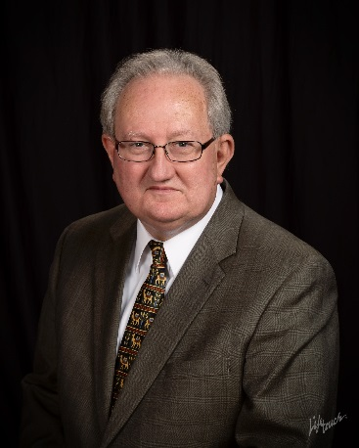
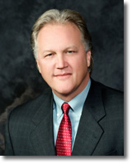
Institutional Leadership
Phillips Community College of the U of A
  Dr. Steven Murray, Chancellor
    Last day June 30, 2015
Mid-South Community College (ASU Mid-South)
  Dr. Glen Fenter, President
    Last day June 30, 2015

Slide 20

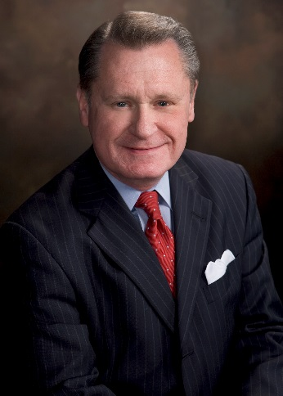
Institutional Leadership
Southern Arkansas University
  Dr. David Rankin
    Last day June 30, 2015
University of Arkansas, Fayetteville
  Dr. David Gearhart
    Last day July 31, 2015

Slide 21
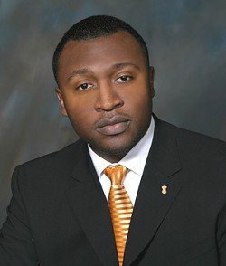
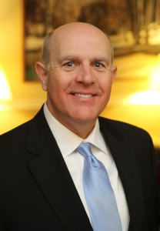
Institutional Leadership
Philander Smith College
  Dr. Roderick Smothers, President
    Began January 5, 2015
Southern Arkansas University
  Dr. Trey Berry, President
    Will begin July 1, 2015

Slide 22
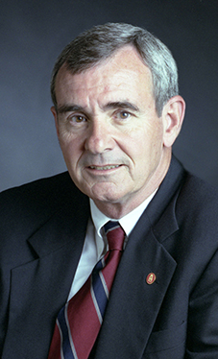
Institutional Leadership
University of Arkansas, Fayetteville
  Dr. Dan Ferritor, Interim Chancellor
    Will begin July 31, 2015

Slide 23
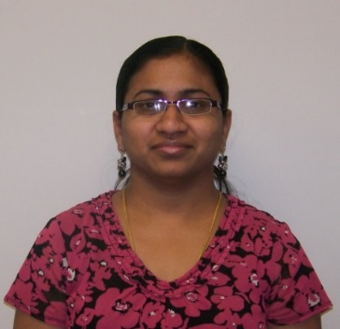
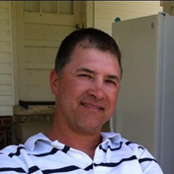
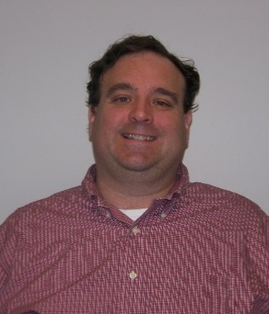
Personnel Changes
Karpagam Arul
Software Support Analyst
Relocated to Houston
Last day was March 2
Chris Wilson
Financial Aid Program Specialist
Resigned
Last day was March 6
Rod Sweetman
Program Specialist
Resigned
Last day was April 30

Slide 24

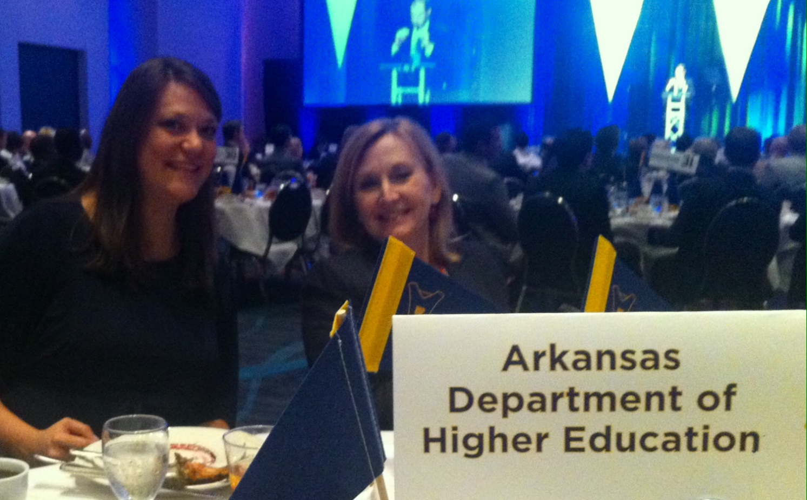
Donald W. Reynolds Gov’s Cup Luncheon
Undergraduate Business Plan Winner
1st Place – $25,000
TIRE – Harding University
Graduate Business Plan Winner
1st Place – $25,000
Agricultural Innovations – Arkansas State University
Notes:
AHECB Members and ADHE staff participated in the Donald W. Reynolds Governor’s Cup Luncheon on April 23 at the Statehouse Convention Center in Little Rock.
Undergraduate AT&T Elevator Pitch Award – $2,000
TIRE – Harding University
Graduate AT&T Elevator Pitch Award – $2,000
Saf-Tech – Arkansas State University
Undergraduate Delta Plastics Innovation Award – $5,000
Conner Innovation – University of Arkansas
Graduate Delta Plastics Innovation Award – $5,000
Agricultural Innovations – Arkansas State University
1st Place Agriculture Award – $5,000
Baby Booster – University of Arkansas
2nd Place Agriculture Award – $3,000
Agricultural Innovations – Arkansas State University
Undergraduate Business Plan Winners
1st Place – $25,000
TIRE – Harding University
2nd Place – $15,000
Charlie’s Choices – John Brown University
3rd Place – $10,000
Opt-In – John Brown University
Graduate Business Plan Winners
1st Place – $25,000
Agricultural Innovations – Arkansas State University
2nd Place – $15,000
Kordate Solutions Inc. – University of Arkansas
3rd Place – $10,000
Baby Booster – University of Arkansas

Slide 25
Legislative Updates
Academic Challenge Scholarship
Governor’s Scholarship
Revenue Stabilization
ADHE Appropriation Bill
Lottery Revenue
Computer Science requirement
Realignment of Higher Education
Unplanned Pregnancies

Slide 26
Arkansas Academic Challenge
SB5/Act 1105 and HB1779/Act1250
Removes Smart Core and GPA from eligibility requirements
(19 ACT or ACT equivalent score to qualify, still remains)
Starting 2016-2017 academic year, changes the award amounts to $1,000 in the first year, $4,000 for the second and third years, and $5,000 for the fourth and final year
  $1,000 and $3,000 at two-year institutions
Changes awards from semester-based to hours-earned basis

Slide 27
Academic Challenge Facts
Deadline for all categories – both spring and fall semester – is June 1
2015-16 awards (went into effect Fall 2014) are $2K, $3K, $4K and $5K as a freshman, sophomore, junior or senior respectively, with $2K only at two-year college
Amounts for those who received the ACS in 2010 and continued his or her eligibility will receive same amounts – $5,000 or $2,500
Amounts for those who received the ACS in 2011 and 2012 and continued his or her eligibility will receive same amounts – $4,500
or $2,250
Changes during this session, that go into effect starting the 2016-2017 academic year

Slide 28
Governor’s Scholarship
HB1836 / Act 850
Eliminates the separate programs of Governor’s Scholars and Governor’s Distinguished
Now only Governor’s Distinguished
Must continue to have one per county
Total of 599 students were awarded due to additional funding
    465 have accepted

Slide 29
ADHE Appropriation Bill
SB97 / Act 978
Special Language on 4-year Funding Formula
Revenue Stabilization Allocation $3,399,182
1% reduction in funding of $41,549
Salary savings used to offset reduction

Slide 30
Lottery Revenue
SB404/Act 1262
Eliminates gambling addiction hotline
Eliminates indirect cost billing from ADHE to Lottery

Slide 31
Computer Science
Computer Science
HB1183 / Act 187
Require a computer science course in all public high schools and charter schools
Task force

Slide 32
Realignment of HE
Realignment of Higher Ed
HB1581 / Act 544
Study the advantages and disadvantages of realigning state-supported institutions of higher education
Identify current redundancies that exist with the current structure of higher education in Arkansas
Determine what mechanisms are currently available or could be available to provide cost savings to state-supported institutions of higher education and to students
Improve accountability to and communications with the General Assembly
Report by November 2016

Slide 33
Unplanned Pregnancies
Unplanned Pregnancies
HB1534 / Act 943
AHECB to create an action plan by November 3, 2015
Unplanned pregnancy prevention information to students
Identify grant funds for prevention activities
Identify educational challenges for single parents
Annual status report

Slide 34
State Authorization Reciprocity Agreement (SARA)
SARA is a national initiative backed by a grant from the Lumina Foundation in cooperation with SREB and other regional education compacts and accrediting agencies.
ADHE must certify Arkansas colleges and universities offering distance technology programs for SARA participation based on institutional accreditation, financial stability, and student complaint resolution policy and procedures.
SARA participation is optional.
Colleges and universities must pay a nominal participation fee to SARA annually. However, ADHE will not charge Arkansas colleges and universities a fee for SARA participation.
ADHE submitted the state application for SARA participation in January 2015 with an effective date of July 2015 for Arkansas colleges and universities to participate in SARA.

Slide 35

ADHE Launches New Website
HIGHER EDUCATION NEWS

Slide 36
Master Plan for Arkansas Higher Education
Proposal May 1, 2015
Brett Powell, Director

Slide 37
Planning Context

Slide 38
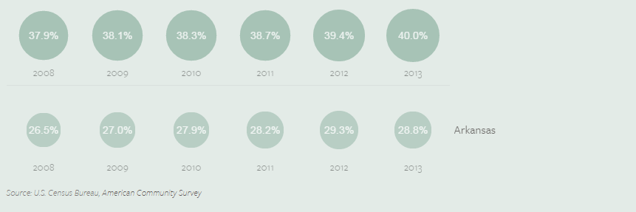

Educational Attainment

Slide 39
State Comparative Data

Slide 40
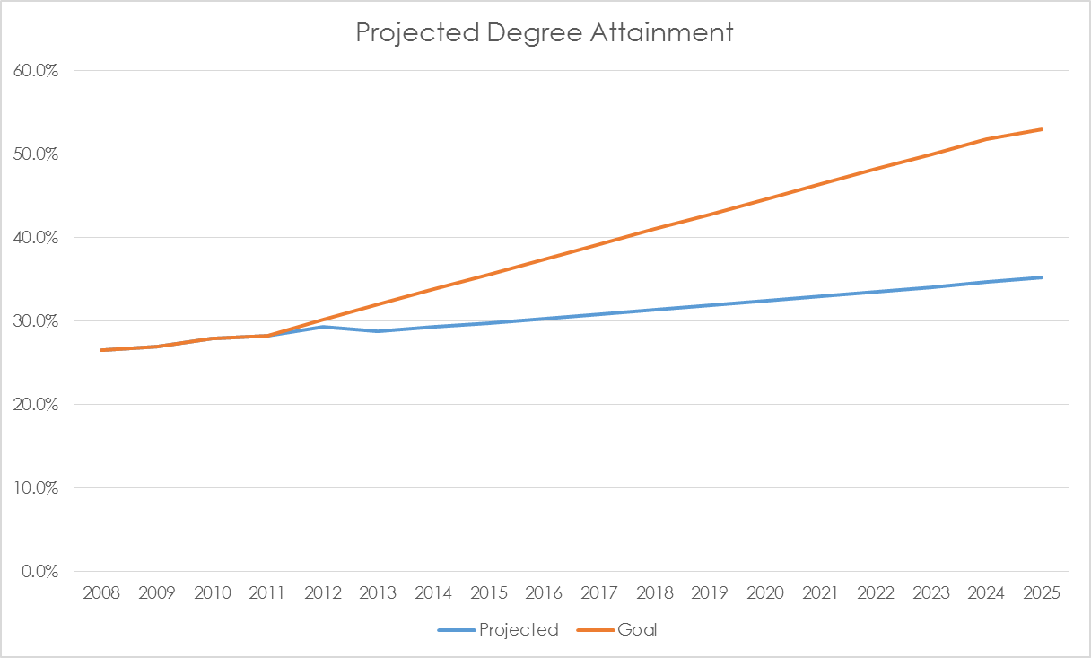
“We can and must double the number of college graduates in Arkansas by 2025 if we are to stay competitive.”
- Governor Mike Beebe, 2011
“Goal 2025: By 2025, 60 percent of Americans will have a high-quality postsecondary credential.”
- Lumina Foundation

Slide 41
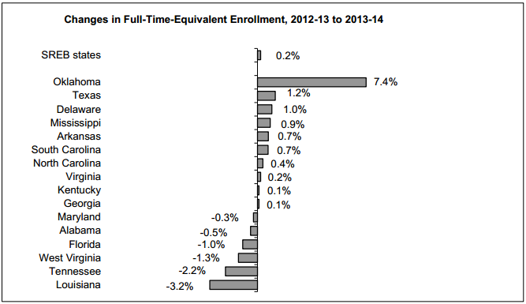
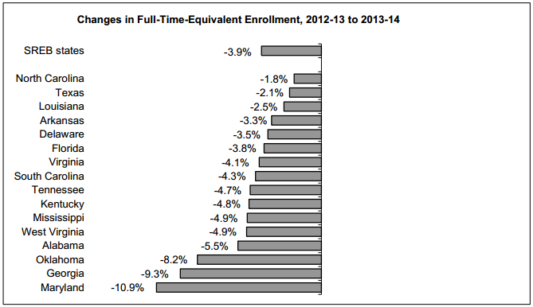
Enrollment Trend
Two-Year Institutions
Four-Year Institutions
SREB State Data Exchange, March 2015

Slide 42
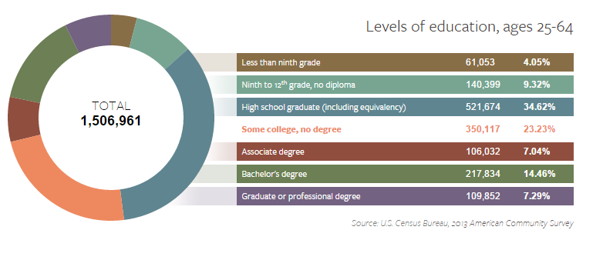
Arkansas Demographics

Slide 43
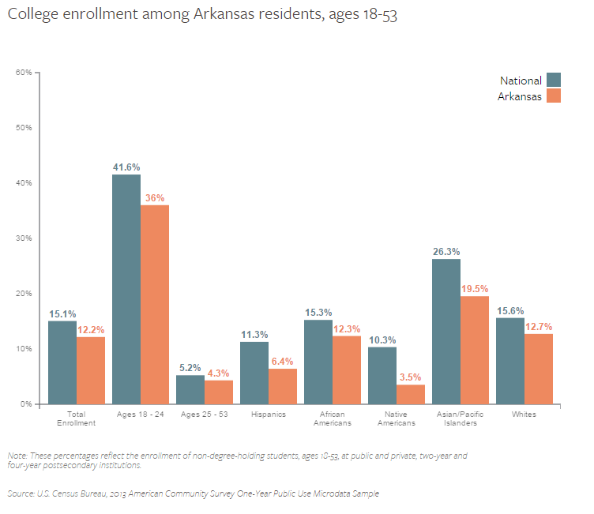

Slide 44
Academic Challenge Investment

Slide 45
Planning Outline

Slide 46
Why a Master Plan?
Coordinate and align information related to postsecondary needs in the state with plans and activities at each of our 44 institutions
Create measurable educational attainment goals based on needs and plans
  Specific to certificate/degree programs and student populations
Provide stakeholders with a clearer understanding of what we accomplish
Create clearer alignment between inputs (Institutional Funding and State Scholarship Programs) and outcomes
A.C.A. § 6-61-205. Master Plan

Slide 47
Design Around 3 Questions
What are the state’s goals and expectations for the higher education system based on needs of students, employers, and economic indicators?
How should higher education be financed to best promote these goals and expectations?
How should the higher education system be held accountable for meeting these goals and expectations?

Slide 48
Core Principles
Collaboration & Coordination
Responsibility & Accountability
Measurement & Assessment

Slide 49
Areas of Planning Focus
Economic and demographic trends
Student Populations
  Adults with some or no credit hours
    Degree completion
    Credit When It’s Due
  Students who are not college ready
    Career Pathways
Pre-enrollment efforts
Retention and completion efforts
State funding formulas
State financial aid programs
Communication and Reporting

Slide 50
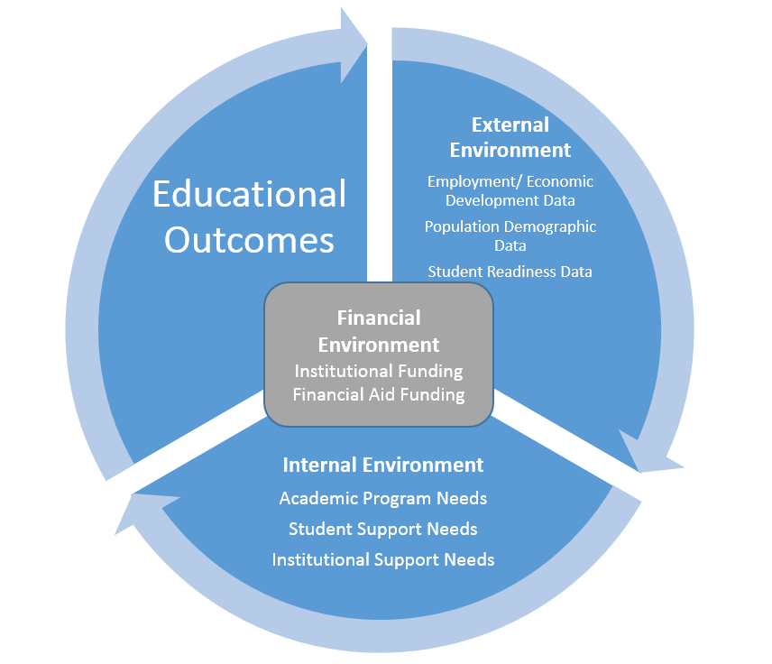
Master Plan
Framework
Notes:
The external environment influences the activities of institutions
The activities of institutions will determine their outcomes
There is a circular nature in that as outcomes improve so does the external environment which starts the cycle again
Funding (both to institutions and to students) is a function of each component of the higher education system

Slide 51
Planning Process
Begin work as soon as possible
Work organized around areas of planning focus
Report completed by October
Implementation upon completion

Slide 52
Dr. Brett Powell
Director
Agenda item no. 2b
workforce initiative act of 2015

Slide 53
Workforce Initiative Act of 2015
Creates partnerships to ensure that Career and Technical Education programs meet critical needs and employment skills gaps
ADHE will disburse all funds to two-year or four-year institutions
Three Phases
  Seek requests for proposals to receive planning grants of up to $100,000.
  Implementation grants in an amount necessary to provide the resources to implement approved projects from phase one – up to $1M over 2 years.
  Continuation grants to phase two recipients that meet or exceed the outcome measures.

Slide 54
Workforce Initiative Act of 2015
Mandatory Partners:
  Technical institute, college or university offering CTE programs
  Employers representing critical needs in the region
  CTE educators or other representatives from a local K-12 school district
Critical Components:
  Local Workforce Development Board input
  Clearly defined CTE pathways (CP, TC, AAS, BAS)
  Basic skills education concurrent with occupational training
  Diversity of student enrollment
  Support services to assist in student persistence
  Apprenticeship or training programs or industry certification

Slide 55
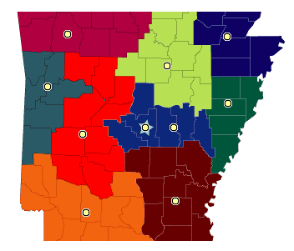
Northwest Arkansas
Benton, Carroll, Boone, Marion, Baxter, Washington, Madison, Newton, Searcy
Northwest Technical Institute
Northwest Arkansas Community College
North Arkansas College ASU – Mountain Home
University of Arkansas, Fayetteville
John Brown University Univ. of the Ozarks
North Central Arkansas
Fulton, Izard, Sharp, Stone, Independence, Jackson, Van Buren, Cleburne, White, Woodruff
ASU – Beebe ASU – Newport
Ozarka College UACC – Batesville
Lyon College Harding University
Northeast Arkansas
Randolph, Clay, Lawrence, Greene, Craighead, Poinsett, Mississippi
Arkansas Northeastern
Black River Technical College
Arkansas State Univ.
Crowley’s Ridge Williams Baptist
Western Arkansas
Crawford, Franklin, Logan, Sebastian, Scott, Polk
Rich Mountain CC
Arkansas Tech - Ozark
Univ. Arkansas – Ft. Smith
Eastern Arkansas
Cross, Crittenden, St. Francis, Lee, Phillips
East Arkansas CC Mid-South CC
Phillips CC of UA
West Central Arkansas
Johnson, Pope, Conway, Yell, Perry, Montgomery, Garland, Hot Spring, Pike, Clark
National Park CC College of the Ouachitas
UACC - Morrilton
Ark. Tech Univ. Henderson State Univ.
Ouachita Baptist Univ.
Central Arkansas and Little Rock
Faulkner, Saline, Pulaski, Lonoke, Prairie, Monroe
Pulaski Tech
Univ. Arkansas – Little Rock
Univ. Central Arkansas
Philander Smith Shorter College
Arkansas Baptist
Southwest Arkansas
Sevier, Howard, Hempstead, Nevada, Dallas, Little River, Miller, Ouachita, Calhoun, Lafayette, Columbia, Union
Cossatot CC of UA South Ark. CC
UACC – Hope SAU Tech
Southern Ark. Univ.
Southeast Arkansas
Grant, Jefferson, Arkansas, Cleveland, Lincoln, Desha, Drew, Bradley, Ashley, Chicot
Southeast Arkansas College
Phillips CC of UA
Univ. Arkansas – Pine Bluff
Univ. Arkansas - Monticello

Slide 56
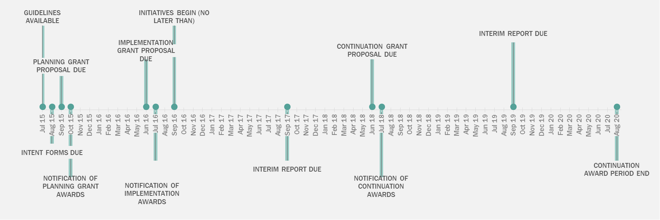
Workforce Initiative Act of 2015

Slide 57
