Slide 1

AHECB Special Meeting
July 26, 2018
Agenda Item 1
Annual Report on the College-Going Rate of Arkansas Public High School Graduates
Sonia Hazelwood
Associate Director, Research & Analytics

Slide 2
Methodology
Each fall ADHE receives data from the Arkansas Department of Education on the most recent public high school graduating class. We link this data to our Student Information System (SIS) to calculate the Annual College-Going Rate. The methodology for this year’s report focuses on students meeting the following criteria:
Graduated from an Arkansas public school district in Academic Year 2016-17
Were reported in SIS as first-time entering college students in Fall 2017 term
Reported as Arkansas resident
This methodology has been in place since 2010 and follows that used by the National Center for Education Statistics (NCES). However, there are several differences:
NCES filters by the age range of 16-24. ADHE ignores age as most high school graduates meet this criteria.
NCES includes GED recipients in their counts. ADHE does not have complete GED recipient data.
Since the NCES report is based on a survey, it may include private high school graduates, and home school students, or students attending college out-of-state. ADHE has no data on annual graduating classes of private high school students or home school students, or students attending college at institutions in other states.
**With these data limitations, the College-Going Rate calculations provided in this report are for Arkansas public high school graduates only attending an Arkansas college or university.

Slide 3
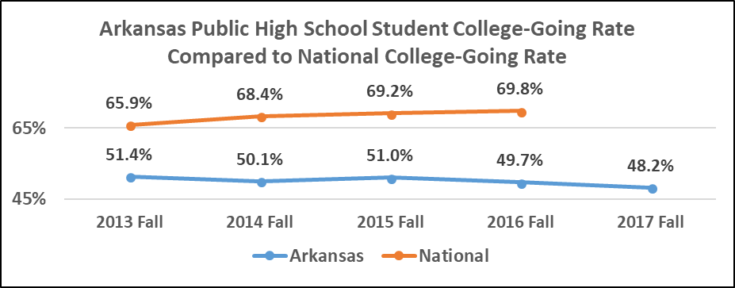
https://nces.ed.gov/programs/coe/indicator_cpa.asp; SIS
The public high school student college-going rate for all Arkansas public and independent institutions for the Fall 2017 term was 48.2%. This represents a decrease of 1.5 percentage points from the previous fall term.
Notes:
Please note what these rates are not telling us…
NCES rates are based on a monthly household survey conducted by the Bureau of the Census for the Bureau of Labor Statistics AND contain college attendance data for GED, home school, and private high school graduates, as well as students who attended college all over the nation. Our SIS cannot track those students so the comparison is not a true comparison.

Slide 4
College-Going Rate – 5 Year Review
Arkansas public high schools experienced a 5.4% increase in the number of high school graduates when comparing 2012-13 to 2016-17. This increase, however, did not improve the College-Going Rate of first-time entering students to an Arkansas institution of higher education. The College-Going Rate of public high school graduates declined 3.2% from 51.4% to 48.2% when comparing 2012-13 to 2016-17 public high school graduates.
Source: SIS

Slide 5
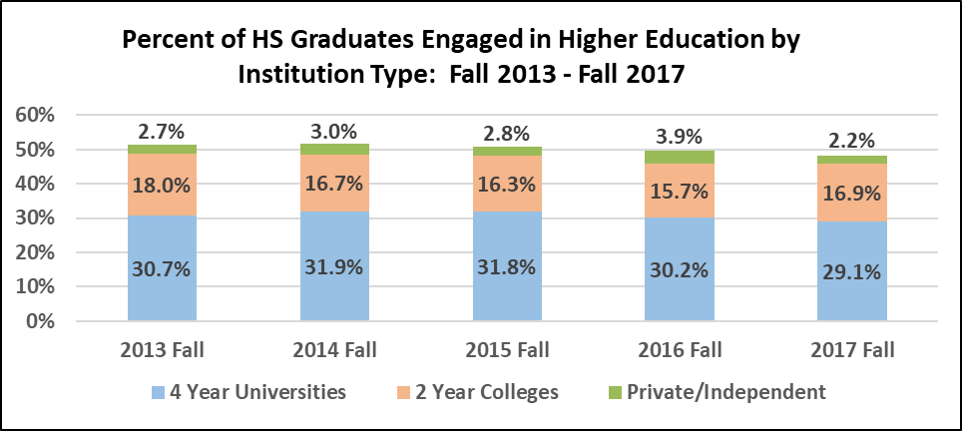
Source: SIS
Over five years, the share of CGR students at 4-Year Universities decreased from 30.7% in 2013 to 29.1%. The share of CGR students at 2-Year Colleges has decreased from 18.0 % in 2013 to 16.9% in 2017. The share of CGR students at Private Institutions has decreased from 2.7% in Fall 2013 to 2.2% in Fall 2017.

Slide 6
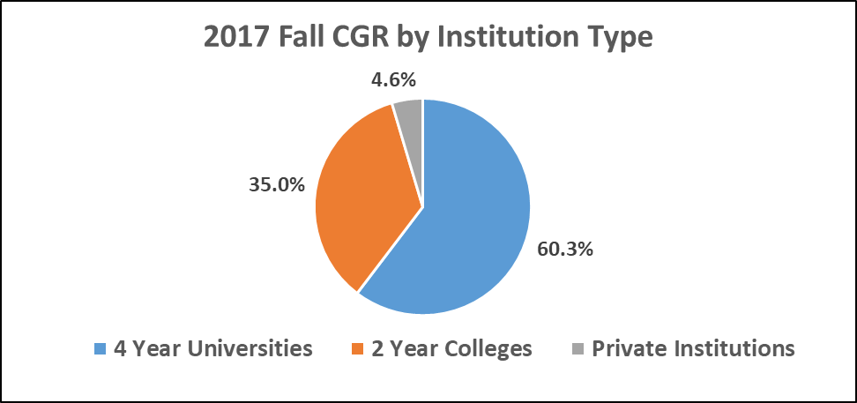
Source: SIS
For the 15,094 public high school graduates the majority enrolled in public 4-Year Universities. This represents a decrease of 0.5% for 4-Year Universities compared to the Fall 2016 entering class, an increase of 3.4% for 2-Year Colleges, and a decrease of 3.2% for Private institutions from last year’s College-Going Rate cohort by Institution Type.

Slide 7
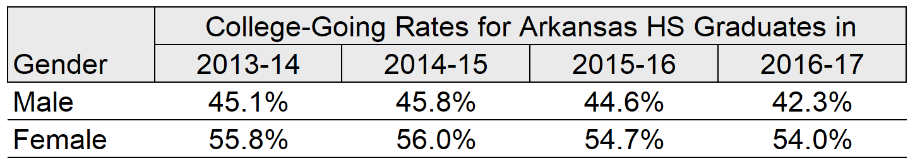
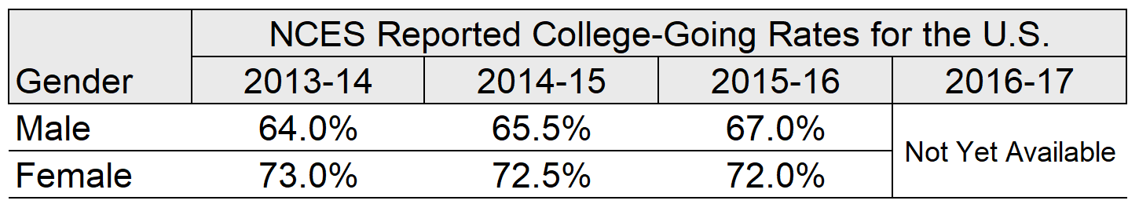
GENDER
The College-Going Rate for Arkansas High School Graduates has declined for both male and female students the past three years.
Source: SIS
According to NCES, the national College-Going Rate for High School Graduates has increased slightly for male students, but decreased slightly for female students the past three years.
https://nces.ed.gov/programs/coe/indicator_cpa.asp

Slide 8
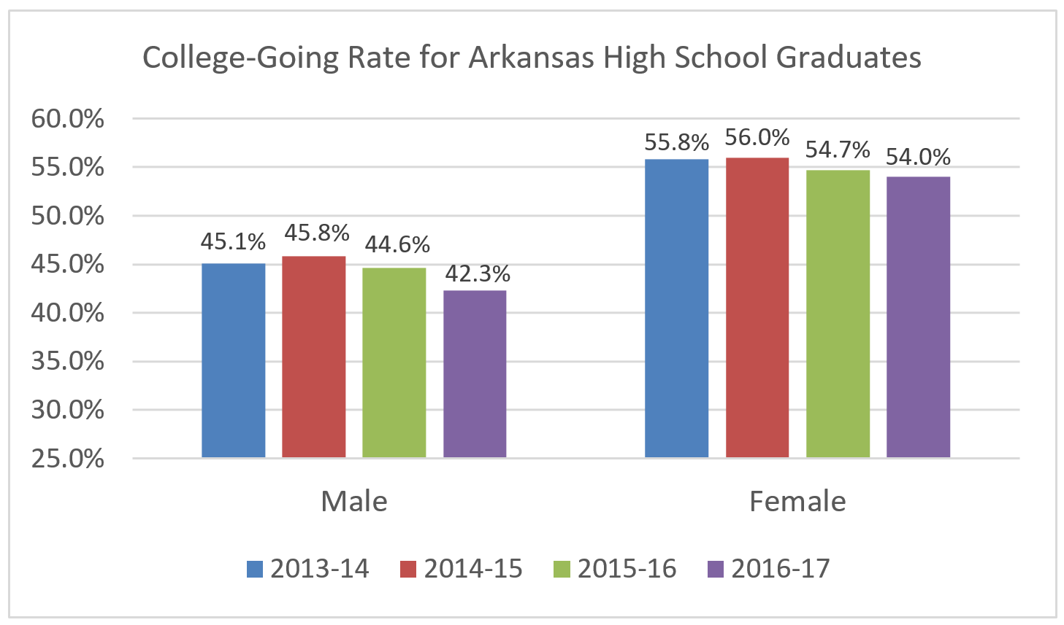
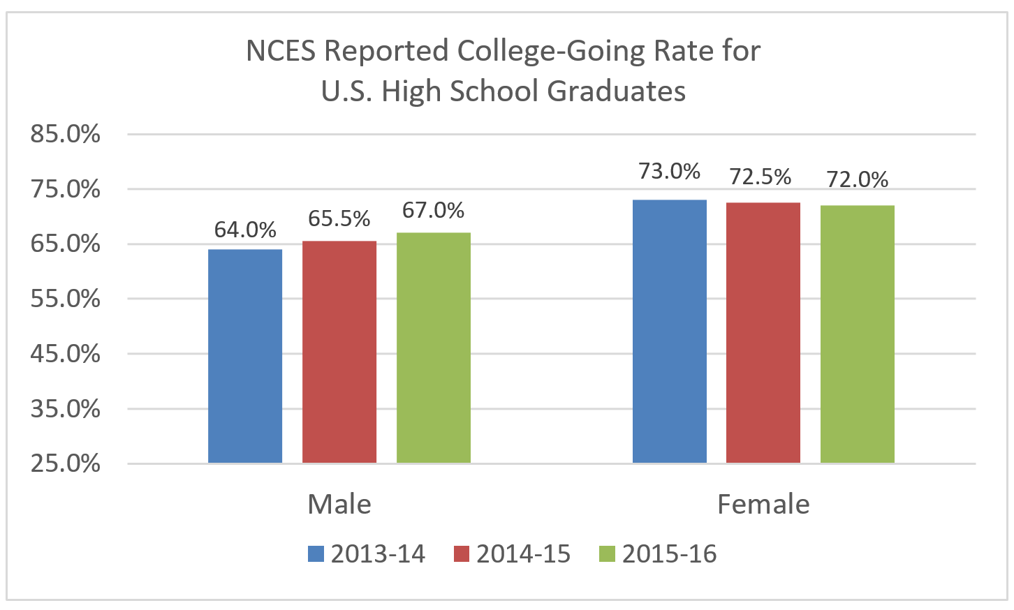
GENDER
Source: SIS
https://nces.ed.gov/programs/coe/indicator_cpa.asp

Slide 9
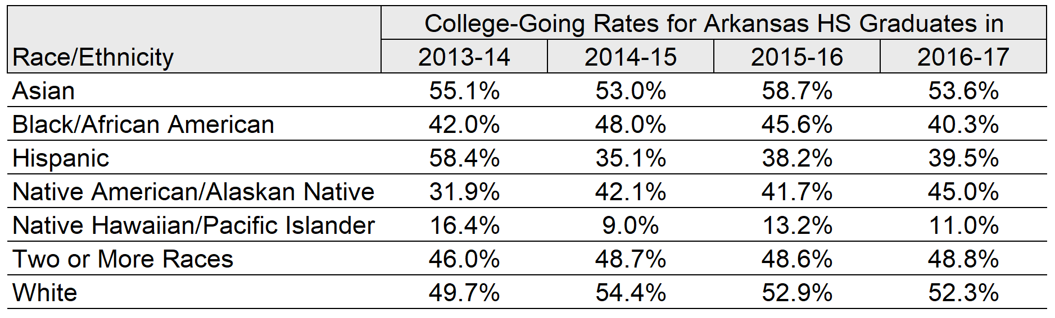
RACE/ETHNICITY
The 2016-17 College-Going Rates for Arkansas High School Graduates has declined for several races compared to the 2015-16 rates. The Asian students showed a decline of 5.1% and the Black students decreased 5.3% over last year’s College-Going Rate cohort. The Native American/Alaskan Native students had the largest one year rate increase of 3.3%.
Source: SIS

Slide 10
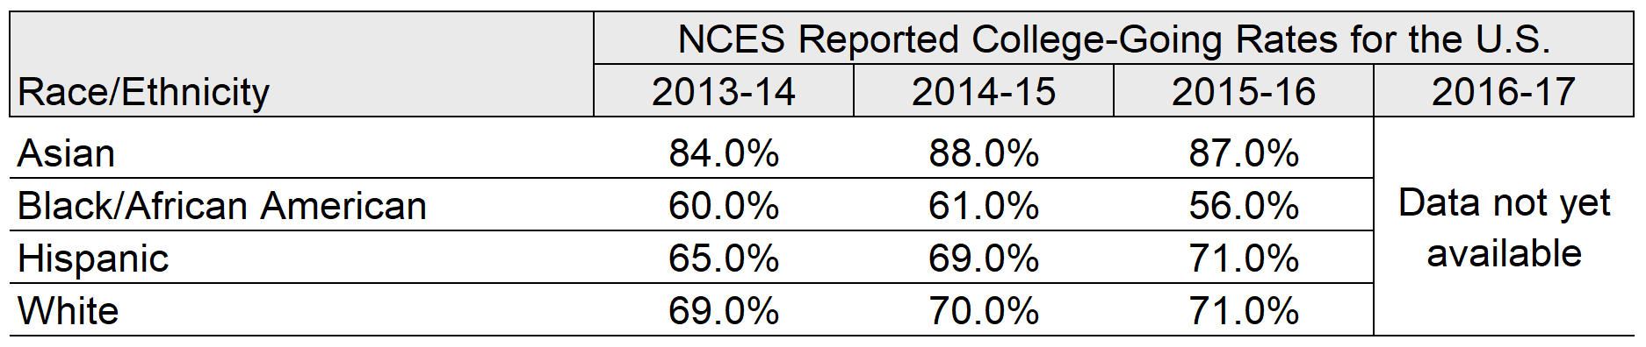
RACE/ETHNICITY
The NCES reported 2015-16 College-Going Rates for U.S. High School Graduates has declined for Asian and Black students when compared to the 2014-15 rates. The College-Going Rates for Hispanic and White students both had modest increases.
https://nces.ed.gov/programs/coe/indicator_cpa.asp

Slide 11
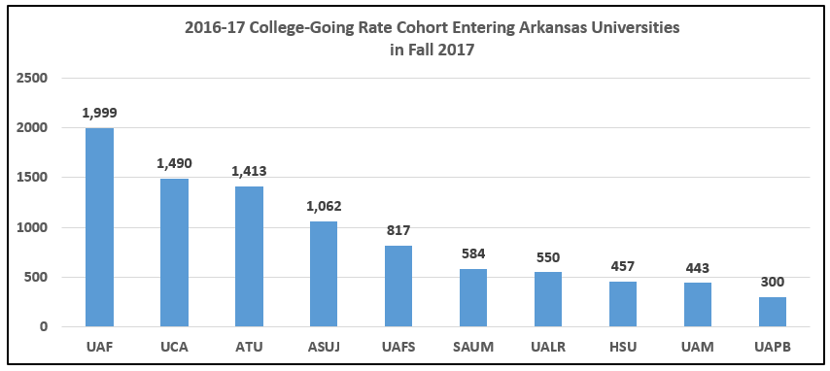
4-YEAR ATTENDANCE
Source: SIS
Program areas
With most credentials Awarded
Program areas
With most credentials Awarded
Program areas
With most credentials Awarded
#1
Health Professions
& Nursing
#1
Health Professions
& Nursing
#1
Health Professions
& Nursing
Business &
Management
Business &
Management
Business &
Management
#3
Education
#3
Education
#3
Education
Notes:
Remember the cohort is in-state students only.

Slide 12
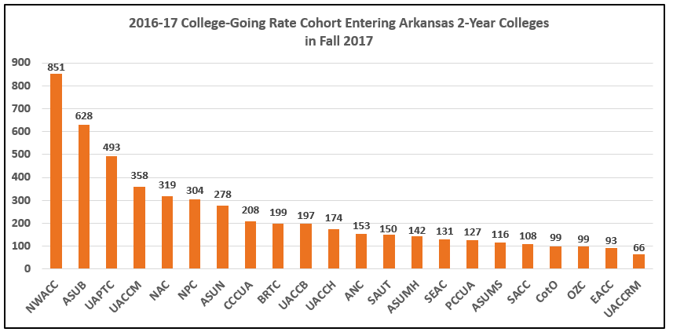
2 YEAR ATTENDANCE
Source: SIS
Program areas
With most credentials Awarded
Program areas
With most credentials Awarded
Program areas
With most credentials Awarded
#1
Health Professions
& Nursing
#1
Health Professions
& Nursing
#1
Health Professions
& Nursing
Business &
Management
Business &
Management
Business &
Management
#3
Education
#3
Education
#3
Education

Slide 13
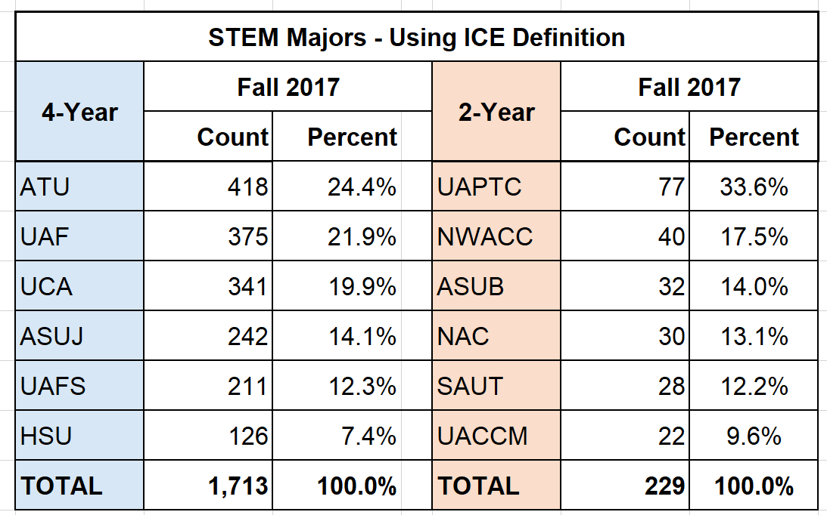
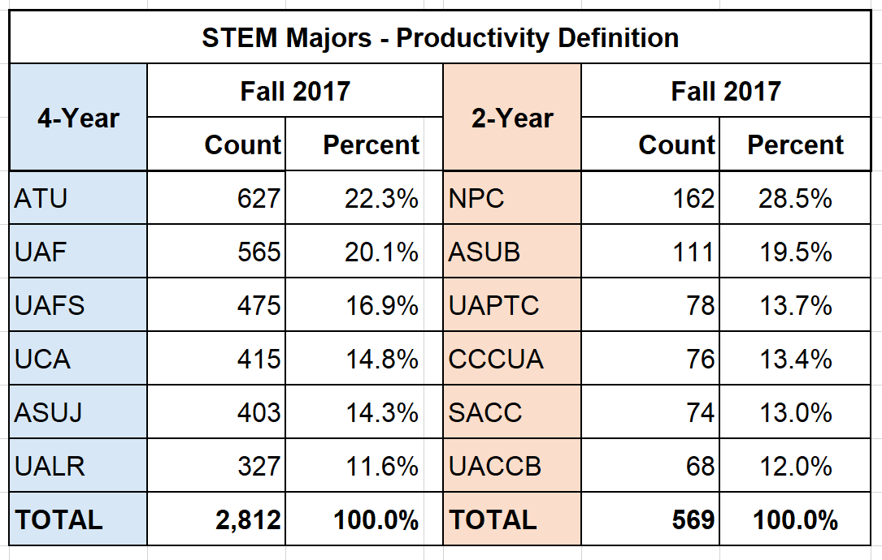
STEM Majors
The following tables provide STEM Major information for the 2016-17 high school graduates who entered a public institution in Fall 2017. The first table uses the original STEM program list and the second table includes CIP codes added to the previous STEM list during the Productivity Funding Model implementation process last year. The tables below provide the top six 4-year and top six 2-year institutions based on number of College-Going Rate cohort STEM majors.
Source: SIS
Source: SIS
Notes:
For consistency purposes, going forward, all agenda items with STEM component will use the new STEM definition as defined by the Productivity Funding Model definition.

Slide 14
Academic Affairs
Special Meeting
July 26, 2018

Slide 15
Annual Review of Faculty Performance
Colleges and universities are required to conduct faculty performance reviews under Arkansas Code Annotated §6-63-104 and AHECB policy 5.5.
ADHE staff is required to monitor faculty evaluation processes adopted at Arkansas public institutions and report annually to the AHECB and Legislative Council.
All institutions conducted faculty performance reviews during 2017-2018 using a variety of methods including assessment by students, classroom visits by administrators, peer review, and self-evaluation activities.
Student Ratings
External Perspective
Artifacts
Agenda Item No. 2

Slide 16
Annual Review of Faculty Performance Notable Findings
Institutions have implemented a variety of training programs to strength faculty development around performance review elements:
  Advising Techniques (e.g. intrusive advising, coaching, and mentoring)
  Tools/approaches to assess student learning outcomes (capstone projects, eportfolios, rubrics)
Development of quantitative/qualitative component ratings of faculty
  Utilization of technology in the classroom
  Participation in English training including: English as a Second Language courses, and accent reduction training.
Agenda Item No. 2

Slide 17
Academic Program Review
Arkansas Code §6-61-214 requires that the AHECB review existing academic programs at Arkansas public colleges and universities.
The existing academic program review policies (AHECB Policy 5.12) were adopted in 1988 and revised in 1995, 1998, and 2008.
Agenda Item No. 3

Slide 18
Academic Program Review Summary
ANC (14) | CCUA (9) | PCCUA (3) | UAPTC (11) | UCA (33)
ASUB (12) | COTO(8) | SAUM (12) | UAF (36) | ASUMS (0)
ASUJ (30) | HSU (8) | SAUT (5) | UAFS (19) | EACC(0)
ASUMH (9) | NAC (13) | SEARK (2) | UALR (47) | SACC(0)
ASUN (2) | NPC (19) | UACCB (12) | UAM (6) | UARM (0)
ATU (19) | NWACC(17) | UACCH (11) | UAMS (2)
BRTC (8) | OZ(8) | UACCM (13) | UAPB (2)
Total Review Completed 2017-2018: 390
Agenda Item No. 3

Slide 19
AHECB Program Viability Standards
AHECB Program Viability Standards
Degree Level | Standard
Graduates Over a Three-Year Period
01 Certificate of Proficiency 02 Technical Certificate 03 Associate Degree (AAS Only) | 12
03 Associate Degree (AA, AS, and AAT) | 18
Graduates Over a Five-Year Period
05 Bachelor Degrees | 18
05 Bachelor Degrees (in science, mathematics, engineering, foreign languages, middle school education, and secondary education programs for licensure in science and mathematics) | 12
07 Master’s Degree | 12
08 Specialist | 12
17 Doctoral: Research/Scholarship | 6
18 Doctoral: Professional Practice | 12
Agenda Item No. 4

Slide 20
Program Viability Review
4 - Year Institutions Total Programs | Viable Programs at 4 -Year Institutions | Non-Viable Programs at 4 -Year Institutions | Deleted Program or Proposed for Deletion | Percentage of Non-Viable Programs
1415 | 1411 | 4 | 1 | <1%
2 - Year Institutions Total Programs | Viable Programs at 4 -Year Institutions | Non-Viable Programs at 4 -Year Institutions | Deleted Program or Proposed for Deletion | Percentage of Non-Viable Programs
1353 | 1305 | 48 | 5 | <4%
Agenda Item No. 4

