Slide 1
AHECB Meeting
October 28, 2016

Slide 2
Agenda item no. 10: Bond and loan feasibility updates
Chandra Robinson
Program Coordinator, Institutional Finance

Slide 3
Bond & Loan Feasibility Updates
This update consists of the actual terms for bond and loan issues receiving AHECB approval that occurred from October 2015 through October 2016.
Report includes the actual date of bond/loan issue, amount of bond/loan issue and actual bond/loan terms for bond and loans approved during the reporting period.

Slide 4
Agenda item no. 11: Maintenance Report
Chandra Robinson
Program Coordinator, Institutional Finance

Slide 5
Maintenance of New Facilities Report
The AHECB policy for maintenance of new facilities states that a report on the amount transferred to plant funds will be presented annually at the October AHECB meeting
Ensures all newly constructed or purchased facilities will have a source of funding for maintenance
Institutions seeking approval of a loan or a bond issue for the construction or purchase of a new facility must provide for the maintenance of that facility by transferring annually to plant funds Current rates:
$2.50 per gross square foot for an educational and general facility
$1.25 per gross square foot for an auxiliary facility
Report includes the status of the maintenance transfer for each new facility for which a loan or bond issue was approved for the construction or purchase of that facility

Slide 6
Agenda item no. 12: REPORT ON intercollegiate ATHLETIC REVENUES & EXPENDITURES
Jake Eddington
Fiscal Support Manager, Institutional Finance

Slide 7
Athletic Report
A.C.A. §6-62-106 directs AHECB to develop and establish uniform accounting standards and procedures for reporting revenues and expenditures.
The 2015-16 Athletic actual expenditures for state-supported universities was $165.7 million and $558,966 for two-year colleges.
This represents an increase of 7.4 percent over 2014-15

Slide 8
Revenues by Source
Revenues | All Institutions | Percent of Total Revenues
Athletic Generated Income | 108,975,939 | 60.4%
Student Athletic Fees | 24,733,387 | 13.7%
Other Athletic Income | 18,304,262 | 10.2%
CWSP Federally Funded Portion | 259,527 | 0.1%
Other Auxiliary Profits | 14,838,578 | 8.2%
Transfers from Unrestricted E&G | 13,156,184 | 7.3%
Prior Year Fund Balance | 52,822 | 0.0%
Total Revenues | 180,320,699 | 100.0%

Slide 9
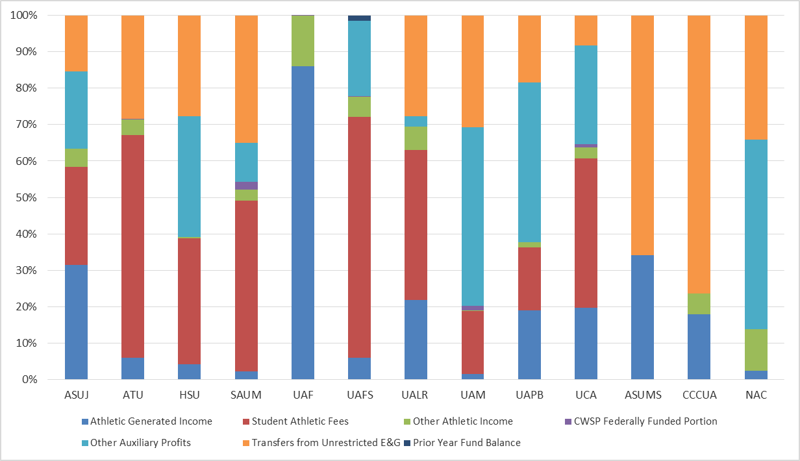
% of Athletic Revenues By Source 2015-16
Athletic Revenues by Source 2009-10

Slide 10
Expenditures by Source
Expenditures | All Institutions | Percent of Total Revenues
Personnel Costs | 117,389,205 | 35.4%
Scholarships | 57,486,544 | 17.3%
Recruiting | 6,204,700 | 1.9%
Team Travel | 31,736,130 | 9.6%
Game Expenses | 21,709,078 | 6.5%
Equipment and Facilities | 31,709,092 | 9.6%
Debt Service | 22,606,266 | 6.8%
Other Expenses | 37,731,545 | 11.4%
Transfers Out | 5,092,564 | 1.5%
Total Expenditures | 331,665,125 | 100.0%

Slide 11
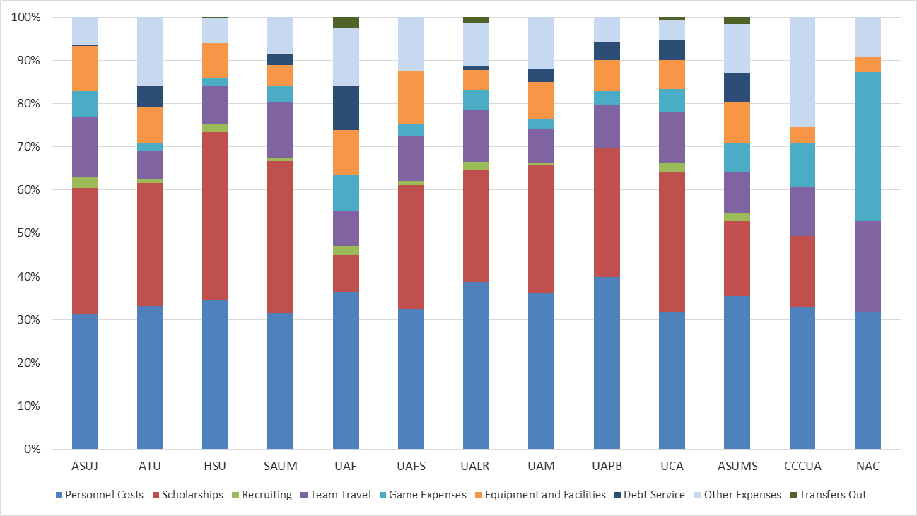
% of Athletic Expenditures By Source 2015-16
Athletic Revenues by Source 2009-10

Slide 12
ACADEMIC COMMITTEE Consent Agenda Items
Ann Clemmer
Senior Associate Director, Academic Affairs

Slide 13
Consent Items
*13. Henderson State University
Bachelor of Science in Education in Computer Science &
Business Technology Education
*14. University of Arkansas, Fayetteville
Doctor of Occupational Therapy

Slide 14
Agenda Item no. 15 Institutional Certification Advisory Committee: Resolutions
Alana Boles
Program Specialist, Academic Affairs

Slide 15
Institutional Certification Advisory Committee (ICAC)
10 Colleges and Universities
34 Programs
Arkansas College of Health Education – Doctor of Osteopathic Medicine

Slide 16
Agenda Item no. 16 Letters of Notification
Lillian Williams
Program Specialist, Academic Affairs

Slide 17
Letters of Notification
Programs approved by the ADHE Director
Programs must be included on the AHECB agenda prior to initiation
Programs are reasonable and moderate extensions of existing certificates and degrees

Slide 18
Agenda Item no. 17 Letters of Intent
Lillian Williams
Program Specialist, Academic Affairs

Slide 19
Letters of Intent
Notification of institutional plans to offer new programs or organizational units that require Coordinating Board approval
Chief academic officers and chief executive officers can comment on the proposals before consideration by AHECB

Slide 20
Approve Minutes
July 29 Regular Meeting
September 30 Special Meeting

Slide 21
Appointment of Nominating Committee
Chairman Bob Crafton will appoint members of the Arkansas Higher Education Coordinating Board nominating committee. The nominating committee will recommend Board officers for 2017-18 at the January 27, 2017 meeting.

Slide 22
Nominating Committee
Dr. Jim Carr, Chair
Dr. Michael Stanton
Sam Sicard

Slide 23
2017 Coordinating Board Meeting Schedule
The proposed 2017 schedule for these regular quarterly meetings follows:
January 26 - 27, 2017 Southern Arkansas University, Magnolia
April 20 - 21, 2017 Arkansas Tech University in Russellville
July 27 - 28, 2017 U A Cossatot in De Queen
October 26 - 27, 2017 Arkansas State University-Mountain Home

Slide 24
AHECB
October 28, 2016
Director Maria markham, phd

Slide 25
Agency updates
No personnel changes
Policy and procedure review
15toFinish
ACTS course review

Slide 26
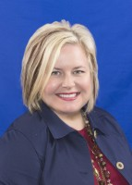
Agency updates
Alana Boles has been elected Chair of the SREB SARA Steering Committee at the SREB SARA meeting in Atlanta.

Slide 27
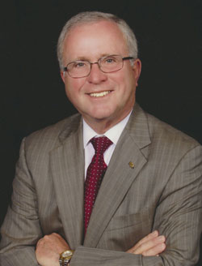
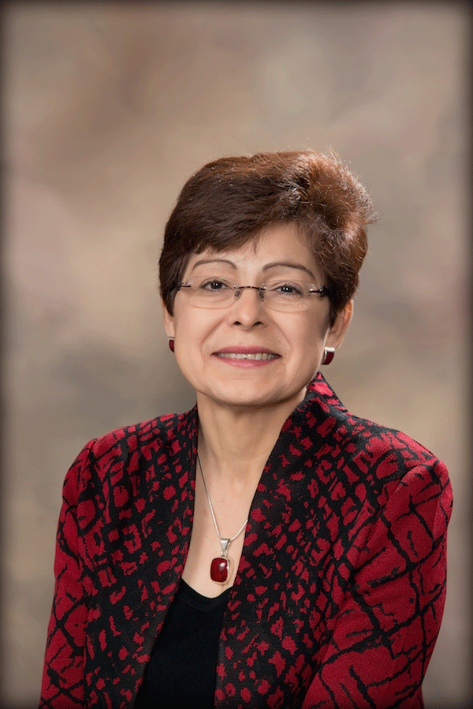
Institutional Leadership
Arkansas State University - Jonesboro
Dr. Doug Whitlock, Interim Chancellor
Began September 2016
Whitlock
University of Arkansas at Little Rock
Dr. Zulma Toro, Provost/Executive Vice Chancellor
Leaving December 31, 2016
Toro

Slide 28
Funding Workgroup
Continue to meet monthly
Making steady progress
Lumina conference
Workforce advisory group
Press conference

Slide 29
Concurrent Advisory Group
Placement testing cannot include predictors
Institutions free to set their own rates
ADHE will verify credentials via random sampling

Slide 30
SREB Report on Affordability

Slide 31
SREB Report on Affordability

Slide 32
SREB Report on Affordability

Slide 33
Director Campus Visits
ASU Mountain Home
Ozarka College
University of Central Arkansas
Clinton School
Southern Arkansas University
South Arkansas Community College
University of Arkansas System
Arkansas Community Colleges
Arkansas Northeastern College
UA Division of Agriculture
Pulaski Technical College
Arkansas State University System
College of the Ouachitas
National Park College
South East Arkansas Community College
University of Arkansas Little Rock
Arkansas Tech University
ASU Mid-South
East Arkansas Community College
Criminal Justice Institute
UA Cossatot
Henderson State University
UA Medical Sciences
University of Arkansas Fayetteville
Black River Technical College
ASU Newport
UACC Morrilton
Phillips Community College
Rich Mountain Community College
UACC Hope
Southern Arkansas University Tech

Slide 34
REVIEW OF AUDIT REPORT BY GOVERNING BODY
Dr. Maria Markham
Director

Slide 35
Review of Audit Report
In accordance with A.C.A. §10-4-418, the Director of the Department of Higher Education will report on the 2016 audit findings, comments and recommendations to the Higher Education Coordinating Board.

Slide 36
In March of 2014, ADHE was able to reorganize the finance department. It was at this time that many new procedures were put into place to further segregate duties. ADHE has complied with all of the audit recommendations.

Slide 37
Program Deletions
AHECB Meeting - October 28, 2016

Slide 38
Phylesia Davis
IT Senior Project Manager / State IPEDS Coordinator

Slide 39
Program Deletions

Slide 40
Program Deletions by Institution Type

Slide 41
Program Deletions by Degree Level

Slide 42
4-Year Universities

Slide 43
2-Year Colleges

Slide 44
Alana Boles Coordinator, Academic Affairs 2016 ICAC Annual Report

Slide 45
ICAC Oversight
Out-of-State Postsecondary Institutions and For-Profit Institutions
Institutions Exempt from Oversight
State Authorization Reciprocity Agreement

Slide 46
Institutions Certified under ICAC Rules
2015-16: 62 Institutions
12 Arkansas Campuses
61 institutions with programs delivered only through distance technology
11 institutions offering programs both on Arkansas campuses and delivered through distance technology
1 institution offering programs only on an Arkansas campus

Slide 47
Institutions Certified under ICAC Rules
2014: 71 institutions
14 Arkansas campuses
2013: 98 institutions
12 Arkansas campuses

Slide 48
Degrees Offered
July 1, 2015 – June 30, 2016
Type of Degree | Number of degrees offered
Undergraduate | 354
Graduate | 372
Total | 726

Slide 49
Degrees Offered
July 1, 2014 – June 30, 2015
Type of Degree | Number of degrees offered
Undergraduate | 495
Graduate | 409
Total | 904

Slide 50
Student Enrollment and Graduates
July 1, 2015 – June 30, 2016
Total Enrollment – 11,000
Online enrollment – 7,806
Arkansas campus enrollment – 3,194
Total Graduates – 1,238
Online graduates – 589
Arkansas campus graduates – 649

Slide 51
Student Enrollment and Graduates
July 1, 2014 – June 30, 2015
Total Enrollment – 14,583
Online enrollment – 11,135
Arkansas campus enrollment – 3,448
Total Graduates – 1,817
Online graduates – 1,109
Arkansas campus graduates – 708

Slide 52
Graduates by Degree
July 1, 2015 – June 30, 2016
Type of Degree | Number of Graduates by Degree Type
Certificates | 54
Associate of Applied Science Degrees | 520
Associate of Arts/Science Degrees | 43
Bachelor’s Degrees | 277
Master’s Degrees | 333
Doctoral Degrees | 11
Total | 1,238

Slide 53
Graduates by Degree
July 1, 2014 – June 30, 2015
Type of Degree | Number of Graduates by Degree Type
Associate of Applied Science | 511
Associate of Arts/Science | 141
Bachelor | 710
Master | 436
Doctoral | 14
Total | 1,812

Slide 54
Tuition Per Credit Hour 2015-2016
 | ICAC Institutions | Arkansas Public Institutions | Arkansas Public Institutions
 |  | In State Tuition | Out-of-State Tuition
Undergraduate Degrees
Lowest Tuition | $161 | $63 | $109
Highest Tuition | $984 | $284 | $678
Graduate Degrees
Lowest Tuition | $270 | $191 | $386
Highest Tuition | $1,693 | $400 | $988

Slide 55
Tuition Per Credit Hour 2014-2015
 | ICAC Institutions | Arkansas Public Institutions | Arkansas Public Institutions
 |  | In State Tuition | Out-of-State Tuition
Undergraduate Degrees
Lowest Tuition | $161 | $61 | $104
Highest Tuition | $1,004 | $277 | $630
Graduate Degrees
Lowest Tuition | $271 | $187 | $390
Highest Tuition | $1,756 | $388 | $918

Slide 56
Institutions Exempt from Certification
53 institutions offering only church-related training
5 institutions offering programs on military installations
The majority (51% of total annual enrollment) of students enrolled at the institution located on the military installation must be active or retired military personnel and/or their dependents
Out-of-state institutions (primarily public institutions) approved by state higher education agencies to offer degrees by distance technology through a recognized regional or national education compact such as the Southern Regional Education Board (SREB) or the State Authorization Reciprocity Agreement

Slide 57
State Authorization Reciprocity Agreement (SARA)
ADHE must approve Arkansas colleges and universities offering distance technology programs for SARA participation based on institutional accreditation, financial stability, and student complaint resolution policy and procedures.
SARA participation is optional.
Arkansas joined SARA on June 30, 2015; a total of 42 states have joined SARA.
32 Arkansas institutions have joined SARA; over 1,100 institutions have joined nationwide.
Applications from out-of-state institutions have decreased as more states and institutions have joined SARA.

Slide 58
ITT Technical Institute Closing
On September 6, ITT Technical Institute closed.
The Little Rock campus had 126 active students.
The U.S. Department of Education is working with ADHE to help these students to enroll in another institution or to apply for student loan forgiveness.
ADHE regulations require certain institutions to obtain surety bonds to protect students in the possibility that the institution would close; ITT Tech had a surety bond.
The Arkansas Attorney General’s Office will be handling some student complaints from now on.

Slide 59
Angela lasiter Academic Affairs Academic Program Review

Slide 60
2014-2016 Program Reviews
Arkansas Code §6-61-214
AHECB Policy 5.12
Purpose
Process

Slide 61
Angela lasiter Academic Affairs Prevention of unplanned pregnancies among Arkansas young adult college students

Slide 62
2016 Activities
2016 video filmed in Magnolia featuring Arkansas students for use by Arkansas schools during orientation
National Public Radio Segment on Arkansas Colleges
Article published in the June 2016 Arkansas State Board of Nursing Journal

Slide 63
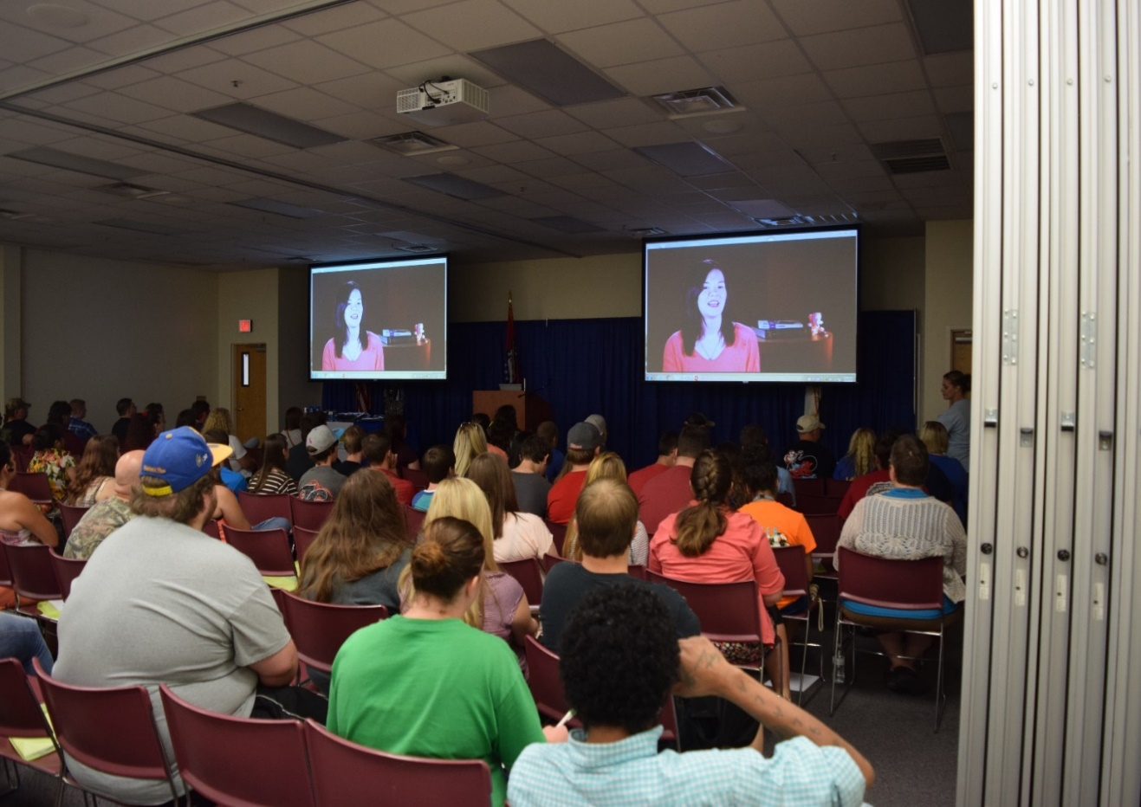
FRESHMAN ORIENTATION A Campus Leading the Pack: College of the Ouachitas
Before watching the video, only 26% of students surveyed said they “knew most of the methods of birth control”.
After the video, almost 70% of students answered in the post survey they “felt they knew most of the methods of birth control including abstinence”.
Before watching the video, students were asked if the information in Act 943 and preventing unplanned pregnancies was important and students agreed with 17%. After the video and orientation, the response in the post survey was almost 92% in agreement.

