Slide 1
Kevin Reilly, PhD
AGB Senior Fellow
Arkansas Department of Higher Education
December 15, 2017

Slide 2
Challenges Confronting Higher Education and Governance
Public skepticism
Spotlight on governance
Fiscal Challenges
State funding
Higher Education’s business model
Access & Success
Regulations & Compliance
Student Aid/Student Debt
Post recession issues
Employment
Economic Confidence
Productivity & Efficiency
Past: Productivity ▲ / Cost ▲
Today: Quality ▲ / Cost ▼
Competition
Other Institutions
New Providers
New Delivery Models
US College Degree Attainment: (Currently ranked 12th globally)
Demographic Change

Slide 10
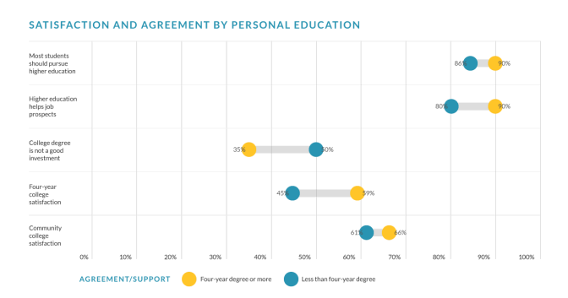
“Most Americans Support Post-Secondary Education” Civis Analytics, 2017. https://www.civisanalytics.com/uploads/2017/11/Civis_Analytics_Higher_Education_Polling_Memo.pdf

Slide 13
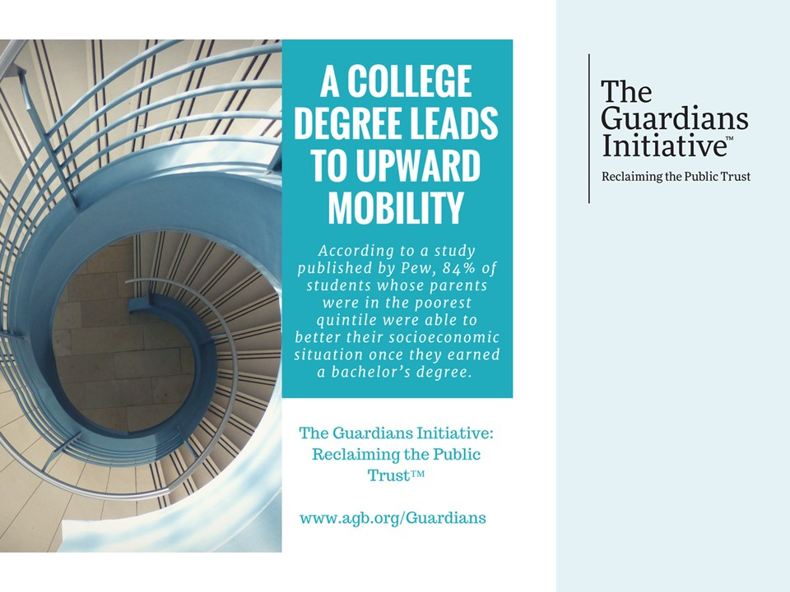

Slide 14
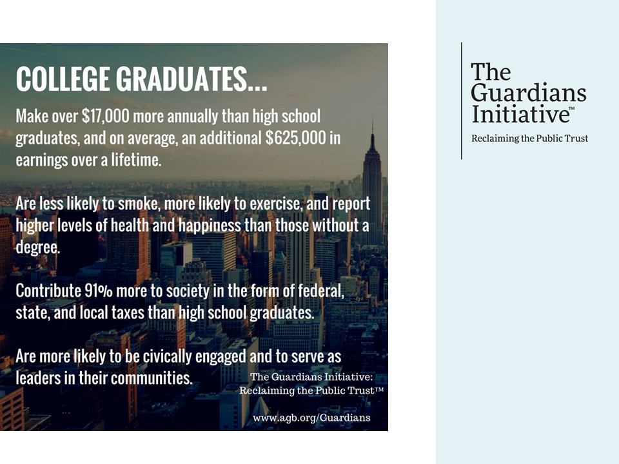

Slide 20
Reactions/Suggestions/Discussion

