Slide 1
2020 Poll Worker Training
General Session
Provided by the:
State Board of Election Commissioners
501 Woodlane – Suite 401N
Little Rock, AR 72201
501-682-1834
1-800-411-6996

Slide 2
Thank You for Serving your Community as an Election Official
The Election is in Your Hands!
This role comes with a great deal of responsibility! Please pay careful attention to the instruction and materials provided to you today.
Use the Training Guides Provided to You
The SBEC has provided a Training Guide and Checklist
Please Follow Along in this Guide During this Training
Don’t Forget to Consult the Guide while Working the Poll
If your county provides additional materials that include local instructions, please consult those materials as well.

Slide 3
Agenda
This training provides instruction for ALL election official’s on conducting in-person voting.
Today’s Agenda:
Opening the Poll
Checking Voters Into the Poll
Failsafe Voting
Other Election Day Issues
Notes:
During voting hours:
Processing voters
Primary & Runoff points of emphasis
Fail-Safe voting, etc.
Assisting voters
Provisional voting
Poll watchers
Electioneering
Spoiled and abandoned ballots

Slide 4
Poll Worker Qualifications
MUST
MUST NOT
Be a qualified elector*
Be able to read & write English
Be a resident of the county
Take oath prior to serving in your official capacity
Attend mandatory training conducted by SBEC
Be guilty of violating any election law
Be a candidate (except county committee) while serving
Be a paid employee of any political party or of any candidate running for any office on the county’s ballot
Be employed by a company doing business with the CBEC
Be married or related to a candidate running for office while serving, if an objection is made
Be a county political party chairman or the spouse of a chairman if an objection is made (Act 258)
Be a CBEC member or the spouse of a CBEC member if an objection is made (Act 258)
IF YOU BELIEVE YOU MAY NOT MEET ANY OF THESE REQUIREMENTS, PLEASE LET THE PRESENTER KNOW NOW OR AT A BREAK.

Slide 5
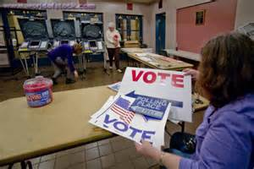
Before Opening the Polls
This section provides general information for all poll workers while more detailed instructions for opening the poll will be provided in the afternoon session.
Specifically, we’ll cover:
Addressing problems
Administering the oath;
Arranging the poll;
Locating supplies, postings, and forms.

Slide 6
What to Do If… - P.3
If you arrive and have issues you cannot address, please contact your County Election Officials:
CBEC Members
Election Coordinator
County Clerk

Slide 7
Before Any Official Duties - P.5
All poll workers are required to take an Oath before they begin serving in your office
The Oath should be stated aloud to another poll worker
You MUST sign under the Oath
If you do not have four poll workers, one of which is a Poll Judge, then contact the CBEC immediately P.3

Slide 8
Before Opening the Polls
Ensure Your Poll Is Accessible to Disabled Voters
Consult local instruction from your CBEC
Arrange the poll
Ensure privacy and accessibility
No one within 6 feet of machine
“The machine shall be placed so that no person can see or determine how the voter casts his or her vote.” A.C.A. §7-5-521
“Each voter shall be provided the privacy to mark his or her ballot. Privacy shall be provided by the poll workers at each polling site or by the county clerk, if the county clerk conducts early voting, to ensure that a voter desiring privacy is not singled out.” A.C.A §7-5-310
Notes:
Before opening the poll, poll workers must verify that a voter can walk up to each machine, vote, and exit the voting area without being able to see the screen of any other machines.
Voters must also be six feet away from all other machines; however, the fact the machines are six feet apart does not necessarily make the poll arrangement lawful.
Each voter must be able to cast his or her vote in private.
The exterior of all voting machines must also be in plain view of the poll workers.

Slide 9
Before Opening the Polls
Activate voting equipment
At least ONE accessible voting machine per poll is required
Generate zero tape(s)
ALL poll workers must sign the zero tape(s)
Post the zero tape(s) on polling room wall
Inspect supplies
Post required information
Notice of Election – Sample Ballots – Voting Instructions – Voting Rights Poster – State/Federal Election Law Poster – List of Registered Voters by Precinct – Poll Watcher Rights and Responsibilities, etc.
Locate forms
PVR List – Lists of Voters – Notice to Provisional Voters – Assisting Voters – Change in Polling Site Authorization – Voter Complaint, etc.
Notes:
a single tape showing the serial # and that the candidate and question counters = 0 for each machine is ok

Slide 10
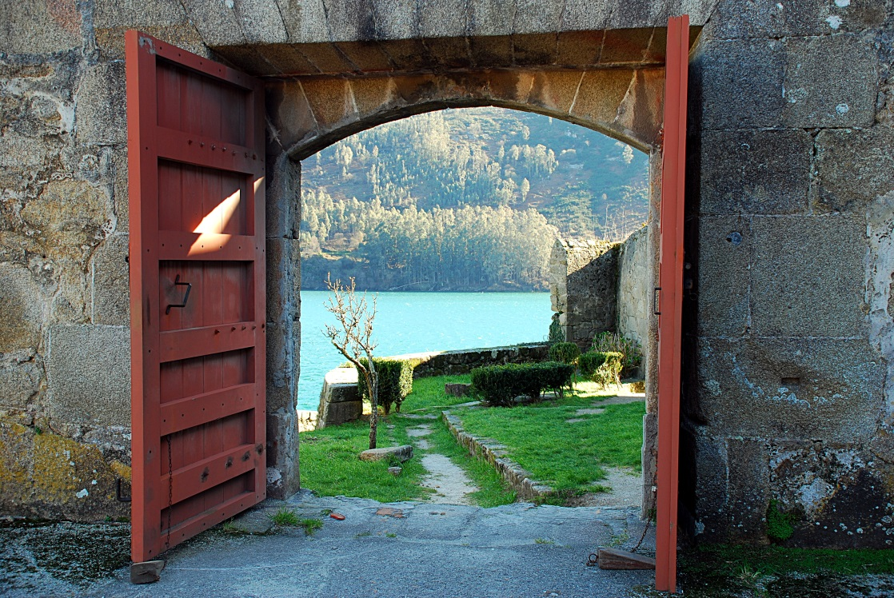
Open the Poll
Open promptly at 7:30am
Keep open continuously until 7:30pm

Slide 11
WHAT IF – Problems Opening the Poll
What if the Poll Tablets cannot be connected to the internet?
Open the poll to voting at 7:30am
Use the tablets in offline mode
Report the problem immediately to the CBEC or designated contact
What if the Poll Tablets fail entirely?
Open the poll to voting at 7:30am
Open the poll using the paper backups, if available
IF no PVR List is available, check in voters by calling the county clerk’s office
Report the problem immediately to the CBEC or designated contact

Slide 12
WHAT IF – Problems Opening the Poll
What if the DS200 Tabulator fails or isn’t available at 7:30am but the ballot markers are working?
Open the poll to voting at 7:30am
Place voted ballots in the emergency slot until the tabulator is operational
Report the problem immediately to the CBEC or designated contact

Slide 13
WHAT IF – Problems Opening the Poll
What if the ballot markers are not functioning?
Open the poll to voting at 7:30am
Allow voters to vote on any provisional paper ballots that are available and cast them in the emergency slot
Report the problem immediately to the CBEC or designated contact
If you cannot reach the county election officials, call the SBEC or Secretary of State!
Our phone number is located on the PW Guide and Checklist

Slide 14
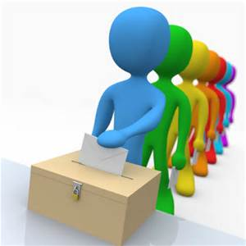
During Voting Hours
This section is intended for poll workers who process voters and contains general information that all poll workers should familiarize themselves with.
We’ll talk about the steps for processing voters and what to expect on Election Day.

Slide 15
How to Process Voters into the Poll
(Step 1-3) p.23
Step 1: Ask the voter to state his or her name aloud
Enter the name into the tablet to find the PVR List Entry for the voter and select the voter’s entry when it is found
If multiple voters have the same name, it may be necessary to enter their date of birth also
Step 2: Ask the voter to state his or her address and date of birth aloud
Poll Watchers must be able to hear the information and have the opportunity to object
DO NOT use a Photo ID to obtain this information
Step 3: Verify that the information given by the voter is the same as the information in the PVR List (tablet)

Slide 16
How to Verify the Name Step 3 (Supplemental) P.23
If the voter’s name varies slightly, but the name is comparable, then move forward
Abby vs. Abbigail
Bill vs. William
If the voter’s name has changed due to marriage, divorce, adoption, etc., then the voter must complete a Voter Registration Application (Votes a Regular Ballot)

Slide 17
How to Verify the DOB Step 3 (Supplemental) P.23
If the date of birth is incorrect in the Poll Book, but the voter asserts this is a clerical error, then continue with the Photo ID process
Provides Photo ID (Showing the DOB stated by the voter) – Have voter complete a Voter Registration Application and issue a Regular Ballot
Does NOT Provide Photo ID – Have the voter vote a Provisional Ballot

Slide 18
How to Verify the Address Step 3 (Supplemental) P.23
If the address stated by the voter differs from the address in the PVR List (tablet), the matter should be referred to the Poll Judge.
This process will be addressed in more detail in the afternoon session.

Slide 19
How to Process Voters into the Poll Step 4 - P.23
Step 4: Check to see whether the voter is “flagged”
Flagged voters have Special ID Requirements:
Must show a CURRENT Driver License - NOT EXPIRED
OR
Must show one of the following: Current utility bill, bank statement, government check, paycheck, or other government document that shows:
Voter's Name and Voting Address

Slide 20
How to Process Voters Into the Poll
Step 5-6 - p.23
Step 5: Ask the voter to provide a Photo ID
Step 6: Use the Photo ID to:
Compare the photo on the ID to the person standing in front of you
AND
Compare the name on the ID to the name in the PVR List (tablet)
DO NOT compare the address on the ID to the address in the PVR List

Slide 21
Requirements for the Photo ID
Step 5-6 (Supplemental) p.23
Voters must verify their registration by showing a document or identification card that shows the name and photograph of the person to whom it was issued and is issued by:
The United States,
The State of Arkansas,
Any Postsecondary Educational Institution accredited in the State, or
The County Clerk
If the Photo ID displays an expiration date, it must either be current or not expired more than four years before the date of the election in which the person seeks to vote

Slide 22
Requirements for the Photo ID
Step 5-6 (Supplemental) p.23
Examples of acceptable Voter IDs include (but are not limited to):
An Arkansas driver’s license;
A concealed carry handgun license;
A US passport;
An employee badge or ID document issued by the State of Arkansas, the federal government, or a postsecondary educational institution located in Arkansas;
A US military ID document;
A student ID card issued by a postsecondary educational institution;
A public assistance ID card; or
A voter ID card issued by the county clerk.
EXCEPTION: Voters who live in a long-term or residential care facility licensed by the state may show documentation from the administrator (Documentation of Residency) attesting that the voter is a resident of the facility

Slide 24
Assessing Validity of ID Step 5-6 (Supplemental) P.35
The poll worker must:
Verify that the name on the ID is consistent with the name in the Poll Book while allowing for abbreviations, nicknames, and name changes;
If the name is consistent, compare the photograph to the voter to determine whether the voter is the person depicted in the photograph while considering changes in hair color, glasses, facial hair, cosmetics, weight, age, injury, and other physical characteristics;
If the poll worker is satisfied that the voter is the person depicted in the photograph and the name is consistent with the name in the Poll Book, then issue the voter a regular ballot;
If the voter’s name has changed, or is different from the name in the Poll Book or the name as stated by the voter, but the poll worker is satisfied that the voter is the person depicted in the photograph, issue the person a regular ballot after the voter completes a voter registration application for the purpose of updating the voter’s information.

Slide 25
Assessing Validity of ID Step 5-6 (Supplemental) P.35
If the poll worker determines that the ID does not depict the voter, or the name is not similar, the voter is referred to the Election Judge of the poll
The Election Judge shall:
Compare the name of the voter to the PVR
Compare the photo to the voter
The Election Judge shall resolve any marginal cases in favor of the voter
If the Election Judge determines that the ID does not depict the voter then the voter is offered a Provisional Ballot

Slide 26
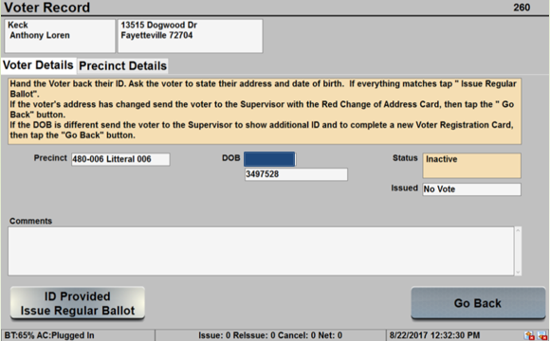
How to Process Voters into the Poll Step 7 - P.24
Step 7: Select the “ID Provided/Issue Regular Ballot” box on the PVR List
Notes:
What have you done so far?
Compared the Stated Name, Address, and DOB to this page
Compared the Name on the ID to this page
Compared the picture on the ID to the voter standing before you

Slide 27
How to Process Voters into the Poll Step 8 - P.24
Step 8: Pass the ID to the poll worker keeping the list of voters
Uses to ensure correct spelling of name
Add name to the numbered List of Voters form
Return ID to voter

Slide 28
How to Process Voters into the Poll Step 9-9a - P.24
Step 9: For Primary Elections, ask the voter “which party primary he or she wishes to vote in.”
Step 9a: Select the appropriate party primary or nonpartisan election

Slide 29
Processing Voters for March Primary Election
For 2020, ballot choices include:
A Democratic ballot containing Democratic party candidates, nonpartisan judicial candidates, any special election issues, and School election candidates and issues (if holding the Annual School Election with the Primary)
A Republican ballot containing Republican party candidates, nonpartisan judicial candidates, any special election issues, and School election candidates and issues (if holding the Annual School Election with the Primary)
A Nonpartisan ballot containing nonpartisan judicial candidates, any special election issues, and School election candidates and issues (if holding the Annual School Election with the Primary)
Voters are now allowed 10 minutes to cast a ballot – Act 664

Slide 30
How to Process Voters into the Poll Step 9b - P.24
Step 9b: For Primary Runoff Elections ONLY:
Check the PVR List to ensure voters do not crossover
Crossover voting occurs when a voter in one primary votes in another party’s primary runoff
Crossover voting is a CRIME

Slide 31
Crossover Voting is a Crime
Voters:
Poll Workers:
It is a misdemeanor, punishable by
up to one year incarceration and a
fine of up to $2,500, for a person to
vote in the preferential primary of
one political party and the general
primary (runoff) of another.
Example: A voter who voted in
the Republican primary
election cannot then
vote in the Democratic party’s
runoff election.
It is a felony, punishable by up to six years incarceration and a fine of up to $10,000, for a poll worker to knowingly permit a person to vote other than his or her legal ballot or fraudulently permit a person to vote illegally.

Slide 32
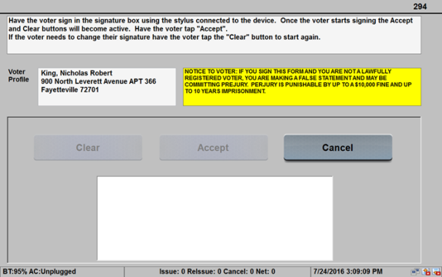
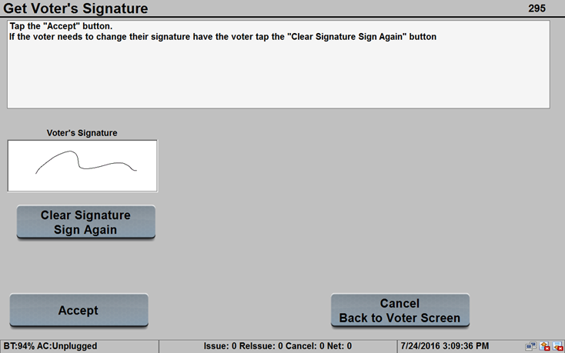
How to Process Voters into the Poll Step 10 - P.24
Step 10: Select “Capture Signature”
Allow the voter to sign
The voter may choose to re-sign if the voter is unsatisfied with the current signature
Click “Accept”
DO NOT reject a voter based on a comparison of signature if your poll book displays the voter’s signature at this point

Slide 33
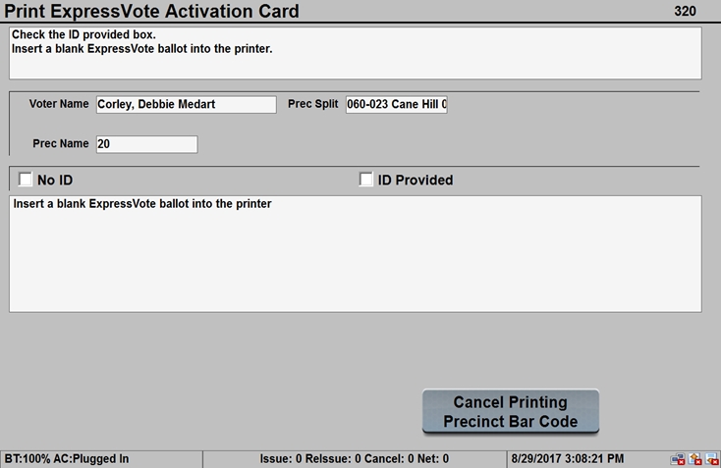
How to Process Voters into the Poll Step 11-14 - P.24
Step 11: After voter signs, then select “Print Precinct Bar Code”
Step 12: Mark the “ID Provided” box
Unless the voter provided a document from a nursing home in lieu of a Photo ID
Step 13-14: Insert a blank ballot into the printer and provide the ballot to the voter

Slide 34
Fail-safe Voting
Steps to take when the Voter’s Statements do not match the PVR List

Slide 35
Fail-safe Voting
If a person attempts to vote and asserts they are eligible to vote in the election then one of three things must happen:
The voter votes a Regular Ballot;
The voter votes a Provisional Ballot; or
If you do not have vote centers, the voter is sent to another poll that has the correct ballot style available.

Slide 36
Voter States an Address that does not Compare (Fail-safe Voting) P.25-26
Situation
How to Proceed
Voter (who is in the PVR List) states their address
Poll Workers compare the stated address to the PVR List
Address in the PVR List differs from the stated address
Poll Worker knows where both addresses are located
Turn the voter over to the Poll Judge
DO NOT proceed unless you or your Poll Judge have called the County Clerk
ALWAYS!
Follow instructions of your Poll Judge and/or the County Clerk
Notes:
What if in the County?
Congressional District Issue

Slide 37
Voter States an Address that does not Compare (Fail-safe Voting) P.25-26
New address in county and assigned to this polling site:
If the address stated by the voter is in the same county (and Congressional District) and the voters at the new address also vote at this poll:
Votes a regular ballot
Ballot style for the “new” address
Voter MUST complete and return an updated voter registration application BEFORE you issue the ballot

Slide 38
Voter States an Address that does not Compare (Fail-safe Voting) P.25-26
Situation
How To Proceed
Voter states their address
The poll workers compare the stated address to the PVR List
Address in the PVR List differs from the stated address
Turn the voter over to the Poll Judge
DO NOT proceed unless you or your Poll Judge have called the County Clerk
ALWAYS!
Follow instructions of your Poll Judge and/or the County Clerk
Notes:
What if in the County?
Congressional District Issue

Slide 39
Voter States an Address that Does Not Compare (Fail-safe Voting) P.25-26
New address in county and NOT assigned to this polling site
NON - VOTE CENTER COUNTY
If the address stated by the voter is in the same county (and Congressional District) and the voters at the new address also vote at this poll:
Votes a regular ballot
Must be sent to the new address polling site with “Change in Polling Site Authorization Form”
Voter MUST complete and return an updated voter registration application
Must be instructed on how to find the new poll
WHAT IF THE ADDRESS COULD NOT BE LOCATED IN THE COUNTY (and Congressional District)?
Notes:
Only 5 Counties Are in two Congressional Districts
Newton
Crawford
Sabastian
Searcy
Jefferson

Slide 40
Voter not In the PVR List (Fail-safe Voting) P.25-26
Situation
How To Proceed
Voter states their name, address, and DOB
The poll workers cannot find the voter in the PVR List
Voter believes he or she is registered
Turn the voter over to the Poll Judge
DO NOT proceed unless you or your Poll Judge have called the County Clerk
ALWAYS!
Follow instructions of your Poll Judge and/or the County Clerk
Notes:
What if in the County?
Congressional District Issue

Slide 41
Voter States an Address that does not Compare (Fail-safe Voting) P.25-26
Voter Not Found in PVR List
If the County Clerk is able to find the voter in the PVR List:
Votes a regular ballot
IF address is assigned to another poll, voter is given the “Change in Polling Site Authorization Form”
Voter MUST complete and return an updated voter registration application

Slide 42
Voter State an Address that does not Compare (Fail-safe Voting) P.25-26
Voter Not Found in PVR List
If the County Clerk is NOT able to find the voter in the PVR List:
The voter is required to vote a provisional ballot
The County Clerk will identify which ballot style is assigned to the precinct part where the address stated by the voter is located
Voter MUST complete and return an updated voter registration application

Slide 43
Voter Believes they have the Wrong Ballot (Fail-safe Voting) P.25-26
Situation
How To Proceed
Voter believes the ballot assigned in the PVR List does not contain the correct races or issues
Name, address, and DOB stated by the voter compare to the information in the PVR List
Notify the voter that they may cast any other ballot available in the poll they believe is correct, but that they will have to vote provisionally
Also inform the voter that they will have to prove there is an error in the county records or the ballots in order for the vote to count
If necessary, send to the Poll Judge to vote a provisional ballot
Notes:
What if in the County?
Congressional District Issue

Slide 44
Voter Received an Absentee Ballot (Fail-safe Voting) P.25-26
If the PVR List indicates that a voter received an absentee ballot then the voter is required to cast a provisional ballot
You should explain the situation to the voter and send them to the Poll Judge
If a voter received an absentee ballot, but did not return it, the provisional vote will count

Slide 45
Voter is Marked as Having Already Voted (Fail-safe Voting) P.25-26
If the PVR List indicates that voter has already voted, the voter still has the option to cast a provisional ballot if they assert they have not actually voted
The County Election Commission will have to determine whether the voter is attempting to vote twice

Slide 46
Ineligible Voters (Fail-safe Voting) P.25-26
In some special elections or school elections not held with the primary or general elections, not all voters in the county are eligible to vote because the election does not affect the entire county
If the PVR List indicates that voter lives outside the area eligible to vote in the election, the voter still has the option to cast a provisional ballot if they believe they are qualified
The County Election Commission will have to determine whether the voter presenting is eligible to vote in this election

Slide 47
PVR List is Marked as “Inactive” (Fail-safe Voting) P.25-26
If you see this notation in the PVR List, you should ignore it
“Inactive” voters are ELIGIBLE and receive a regular ballot

Slide 48
Election Day Issues
Other situations you will need to be prepared to address on Election Day

Slide 49
Procedure for Assisting Voters P.36-37
Poll Worker Must List:
The name of each voter that is assisted; and
The names of the two poll workers who assist the voter
One to assist and one to observe (w/out comment or interpretation);
OR list the name and address of the person chosen by the voter to assist them

Slide 50
Limits on Assisting Voters P.36-37
TWO Poll Workers: May assist an unlimited number of voters
Must be accompanied by a second poll worker!
Third Parties: May assist up to six voters if:
Voter requests the assistance (not the 3rd party)
Candidates: May assist up to six blood relatives
Within two degrees of relationship
All Assistants: Required to ONLY mark the ballot as directed by the voters
Assistants who engage in electioneering should be documented (including their name) and removed

Slide 51
Important Reminders on Assistance to Voters
A voter must personally request help
Poll workers and poll watchers cannot suggest to a voter that he or she needs assistance
Poll workers can allow voters who are unable to stand in line, due to a disability, to move to the front of the line
Ballots cannot be taken out of the polling room during voting hours
A person assisting a voter cannot misrepresent the content of the ballot or change or mark the ballot, except as intended by voter

Slide 52
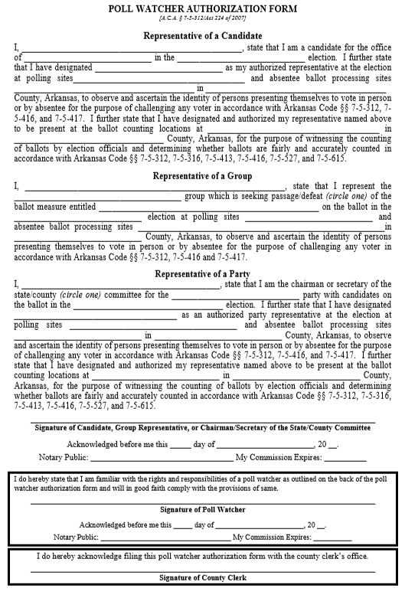
Poll Watchers and Vote Challenges P. 47-50
Poll Watchers are representatives of a candidate, party, or ballot issue group
Must provide a Poll Watcher Authorization Form
Poll Watcher Challenges
A poll watcher must notify a poll worker of the challenge before the voter signs the PVR List;
and
Complete the Challenged Ballot Form on the Provisional Voter Envelope

Slide 53
Poll Watchers Can…
Observe poll workers
Stand close enough to the place where voters check
in to vote so they can hear a voter’s name
Compile lists of voters
Challenge ballots before the voter signs the PVR List
and only on the grounds that:
The voter is not eligible to vote in the precinct; or
The voter has previously voted in that election
Call any perceived irregularity or election law violation
to the attention of the Poll Judge
Notes:
This includes not registered to vote…

Slide 54
Poll Watchers Cannot…
Be within 6 feet of any voting machines or voting
booths
Speak to voters
Try to influence voters:
Inside the poll; or
Inside the prohibited electioneering zones
Disrupt elections

Slide 55
Electioneering P.51-53
What is Electioneering?
The display of, or audible dissemination of, information that advocates for or against any candidate, issue, or measure on a ballot (Act 533 of 2019)
Prohibited within 100 feet
Prevention
Instruct any person entering the poll who is wearing or displaying campaign articles to remove them immediately
Check the poll frequently for campaign articles and remove them promptly
Monitor the electioneering prohibition zone periodically to ensure compliance
Post the Notice on Electioneering

Slide 56
Electioneering P.51-53
Displays of a candidate’s name, likeness, or logo;
Displays of a ballot measure's number, title, subject, or logo;
Audible dissemination of electioneering information;
Handing out literature on any candidate or issue on the ballot;
Soliciting signatures on any petition;
Soliciting contributions; or
Attempting to win votes by wearing or displaying buttons, hats, pencils, pens, shirts, signs, sticklers, or other articles designed to influence voters

Slide 57
Spoiled Ballots P.55-57
Write Cancelled on the ballot, initial the spoiled ballot, and place it in the Spoiled Ballot Envelope
Fill out the Spoiled Ballot Affidavit
No more than 3 ballots may be issued to one voter

Slide 58
Abandoned Ballots P.55-56
Abandoned in the Electronic Ballot Scanner
Abandoned Elsewhere in the Poll (not on scanner or machine)
With Two Poll Workers Present:
Step 1: Override warning on the scanner
Step 2: Complete the process of casting the ballot
Step 3: Document the following on the Abandoned Ballot Log:
Name of the voter;
The time the ballot was found;
Names of the poll workers addressing the issue; and
All other circumstances surrounding the abandoned ballot.
The Abandoned Ballot Log is on Page 59 of your Manual
With Two Poll Workers Present:
Step 1: Write ABANDONED across the face of the ballot
Step 2: Place the ballot in a separate envelope
Step 3: Write Abandoned Ballot on the envelope
Step 4: Document all circumstances on the outside of the envelope
Step 5: Preserve abandoned ballot separately from other ballots
Ballots not found in the tabulator are NOT counted!

Slide 59
Abandoned Ballot Log - P.59

Slide 60
Conflict Resolution
When dealing with difficult voters or situations:
Remain calm and do not escalate the situation;
Turn the problem over to another poll worker, if necessary;
Call your CBEC or local law enforcement agency, if necessary;
Move any disturbance outside the immediate voting area, if possible; and
Document problems.

Slide 61
Candidates in the Poll
No candidates are allowed in person as poll watchers during voting on election day
Candidates may be present in person at an early voting poll:
Only for the purpose of observing
May not challenge voters
Must show ID
If the candidate observing early voting is also a public official:
The candidate may not wear anything that identifies him or her as a public official.
For example, a candidate cannot wear a:
Uniform;
Badge; or
Other apparel or equipment.

Slide 62
STATE BOARD OF ELECTION COMMISSIONERS
501 Woodlane Street – Suite 401N
Little Rock, Arkansas 72201
(501)682-1834 or (800)411-6996
Fax: (501)682-1782
info.sbec@arkansas.gov
www.arkansas.gov/sbec

